Slide 1

Learning Outcomes Tracking Application (LOTA)
Final Panel Presentation

Slide 2


Content
Project Background
Project Overview
Research
Methodology
Project Planning and Tools
Sprint Summary
Design
Development
Testing
Final Documentation and Deliverables
Client Satisfaction
Potential Future Work
Challenges
Team Reflection and Skills Developed
Client: Chalinor Baliuag
Advisor: Richa Panjabi
Team: FAB
Frances Liu
Amarsh Tyagi
Bowang Ding

Slide 3
Project Background
The Information Technology School of Whitireia & WelTec aims to help and ensure that all students achieve all Learning Outcomes (LOs) in the programs.
Passing an assessment does not mean an LO is achieved, since each assessment may evaluate several LOs. Each time a LO is evaluated, it should be passed.
Student should retake the specific failed LO
Currently, tracking the achievements of these LOs is done manually by school staff.
It is difficult for program managers and tutors to manage and monitor the LO progress.
Students also cannot have a clear understanding and view of which LOs they have passed or failed.

Slide 4
Project Overview
LOTA aims to help to track and manage LOs across courses and students.
The project is piloted with the Level 4 NZ Certificate in IT Essentials and Level 5 NZ Diploma in IT Technical Support. Then the application will include Level 6 and Level 7 IT programs.
Users: Admins, Tutors, Students
It improves transparency, supports LO retakes, aligns with accreditation requirements

Slide 5
Research
Investigated
Agile frameworks
How to write proposal
Deployment costs
Similar projects, similar UI design
Design tools of prototype
Different diagrams
Gantt Chart tools
Bug report templates

Slide 6

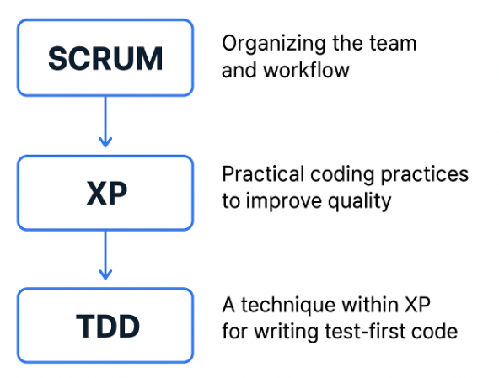
Methodology
Scrum: the project management
iteration
task decomposition
ceremonies: fixed-time + ad hoc team meetings + advisor meetings + client meetings
frequent feedback
Extreme Programming (XP):
software development process
improve efficiency and quality at the coding level
Test-Driven Development (TDD):
one of XP’s practices
focuses specifically on writing reliable, testable code

Slide 7
Project Planning and Tools
Gantt Chart: timeline of key milestones
Trello Board: sticky notes for detailed task, individual responsibilities, to-do list, status of tasks
Communication: emails, WhatsApp, Zoom, in-person meetings

Slide 8
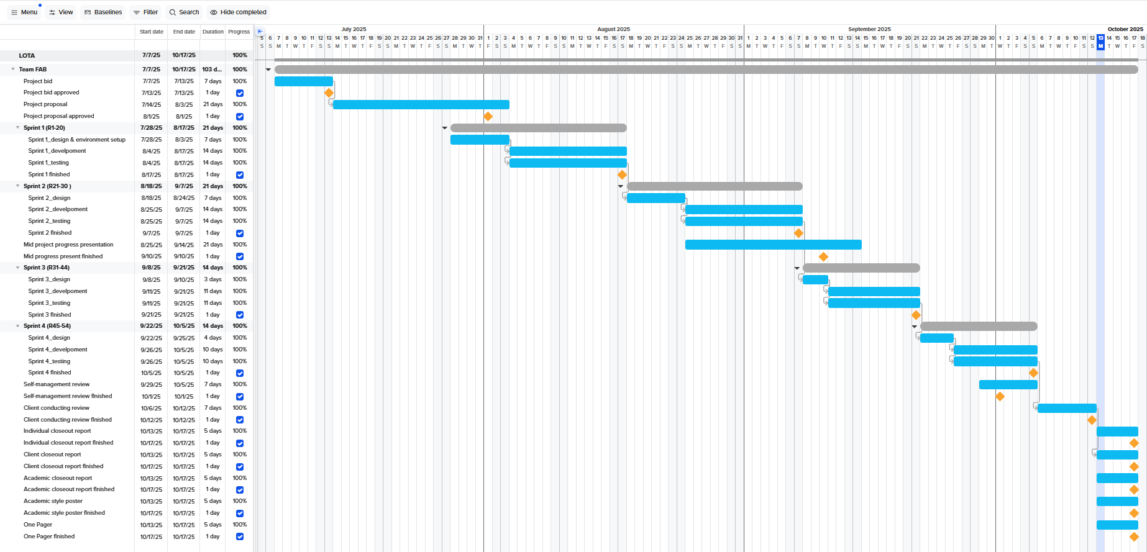
Project Planning and Tools

Slide 9
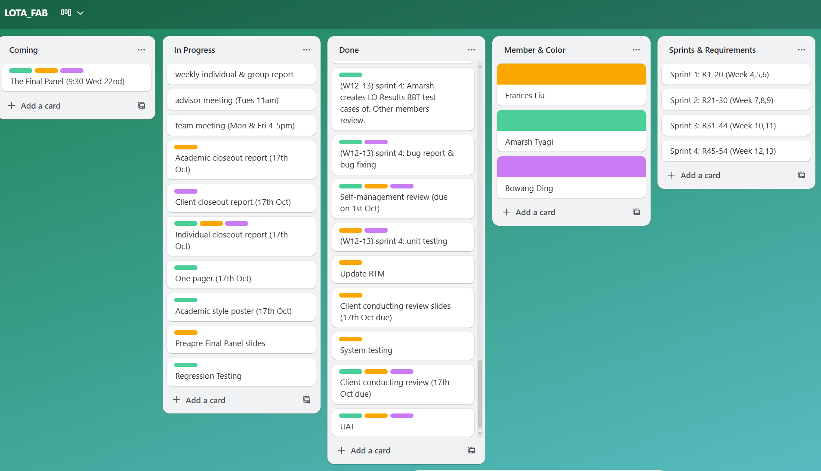
Project Planning and Tools

Slide 10
Sprint Summary
54 requirements
4 sprints
Each sprint: design, development, testing
Sprint 1 (20 functions, admin related functions)
Sprint 2 (10 functions, admin related functions)
Sprint 3 (14 functions, tutor related functions)
Sprint 4 (10 functions, student related functions)

Slide 11
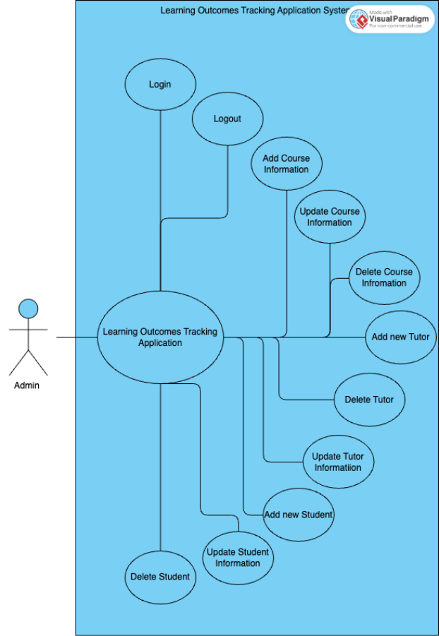
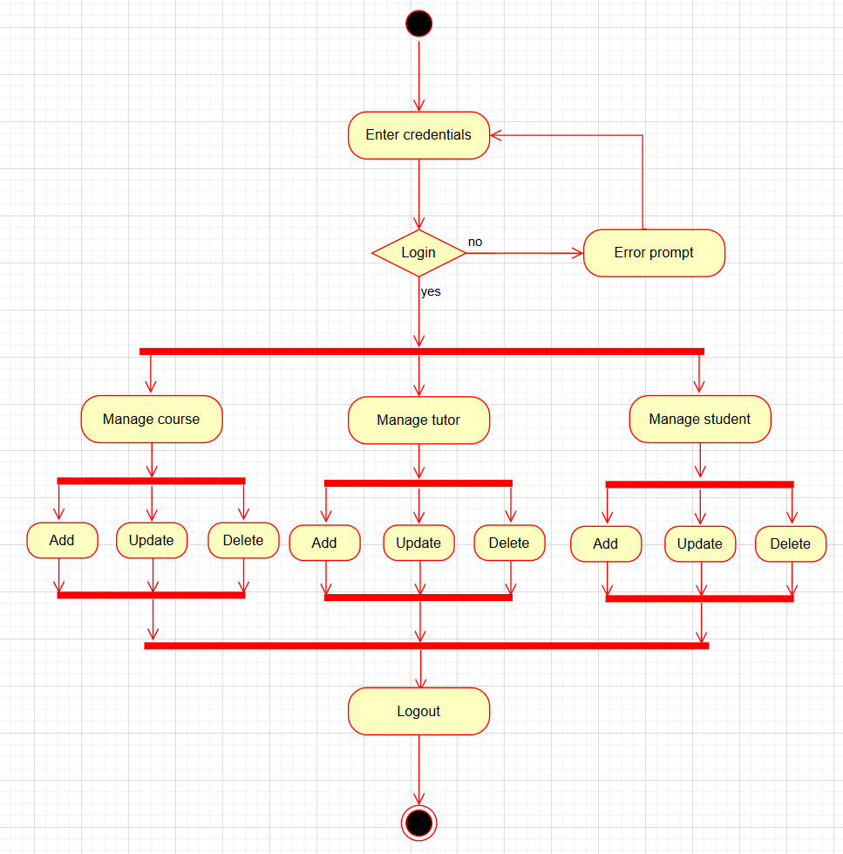
Design
Each Sprint: design, development, testing
Tools: Draw.io and Visual Paradigm
Use Case Diagrams, Activity Diagrams, Wireframes, ERD, Class Diagram

Slide 12
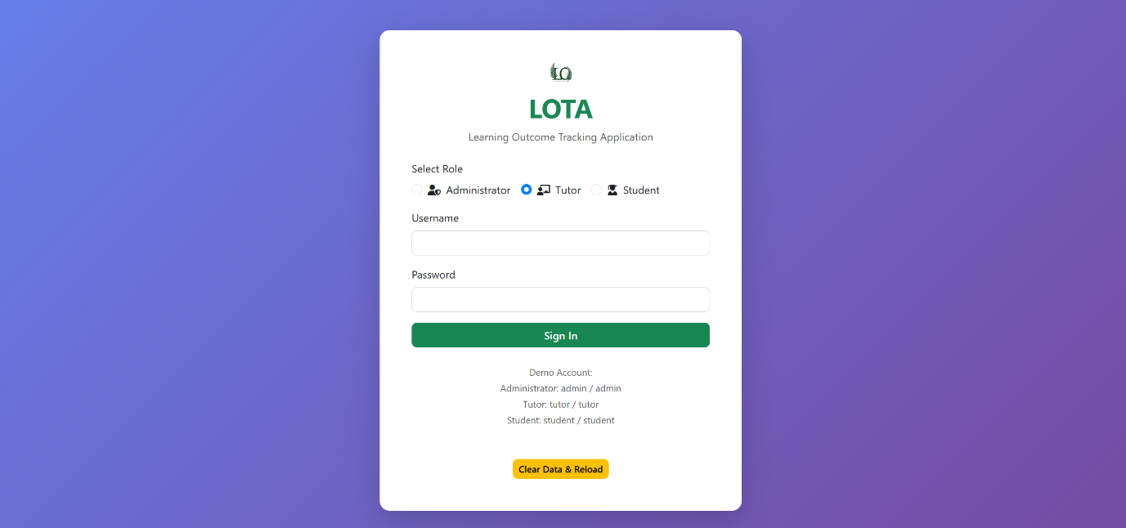
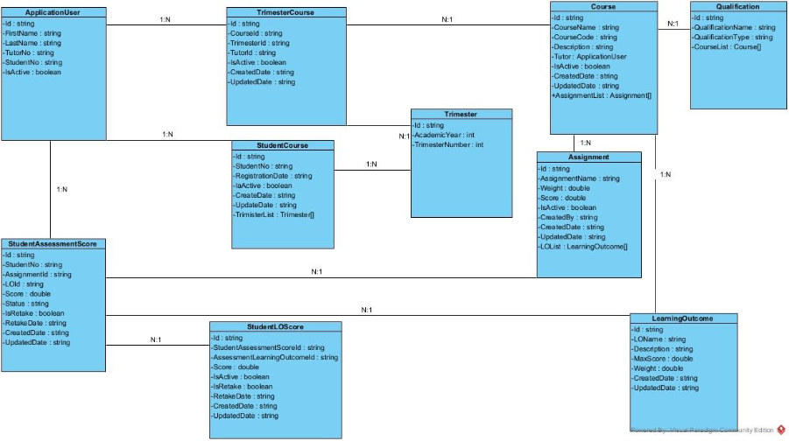
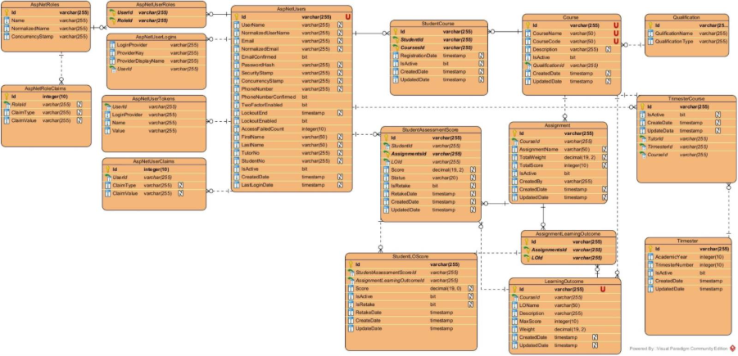
Design

Slide 13
Development
Technologies:
Backend: ASP.NET Core 8 MVC, Entity Framework Core
Front-end: HTML, CSS, JavaScript, Bootstrap
Database: Microsoft SQL Server
Version Control: GitHub
Highlights:
Role-Based Permission Control
Responsive Design: Multi-Device Support
Smart Notification System

Slide 14
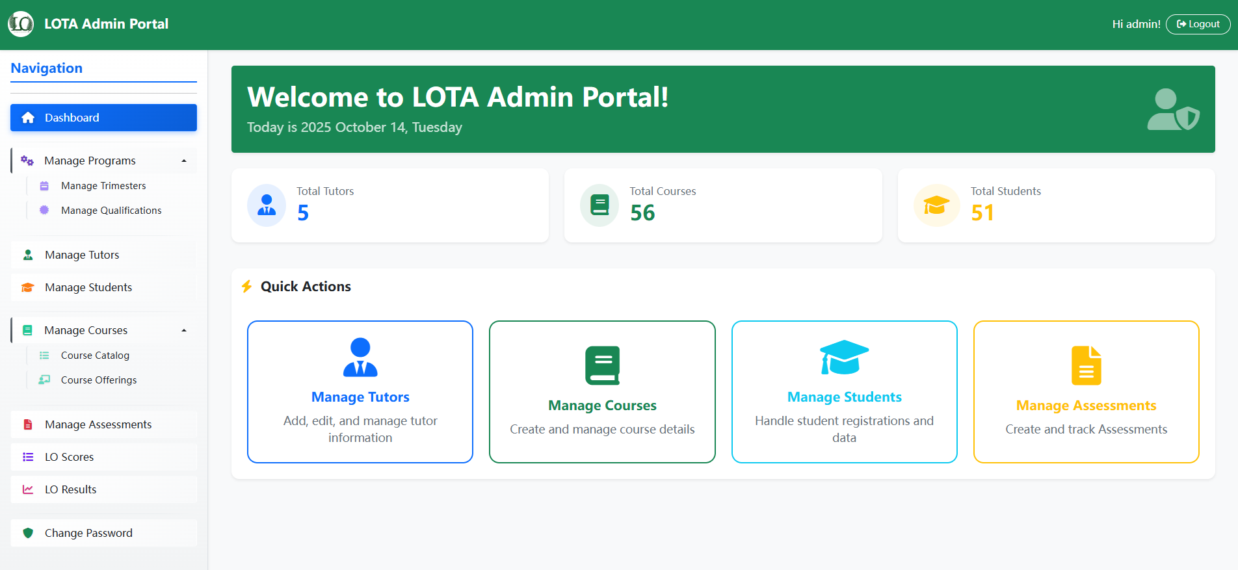
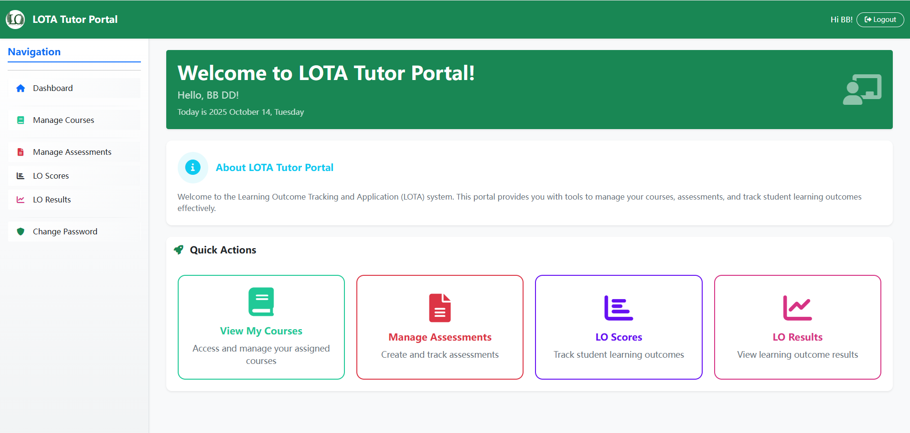
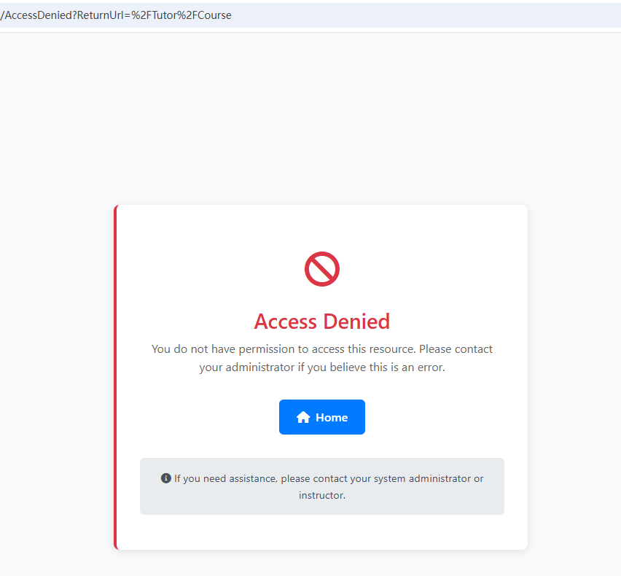
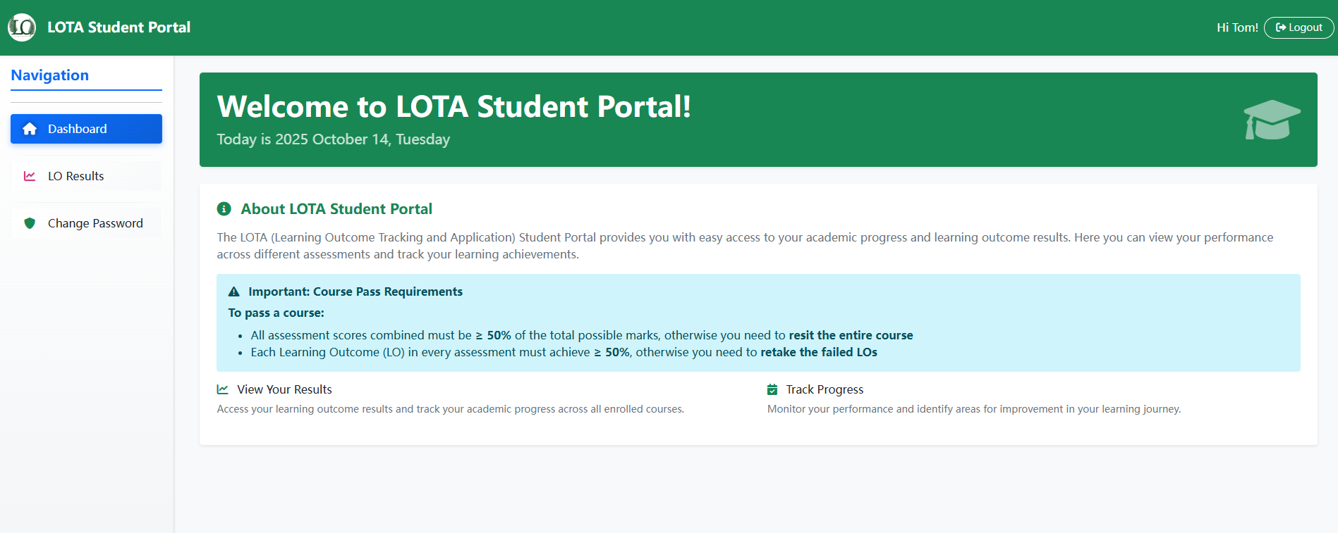
Development
Role-Based Permission Control
Different roles can only access authorized information, preventing misuse and data leakage

Slide 15
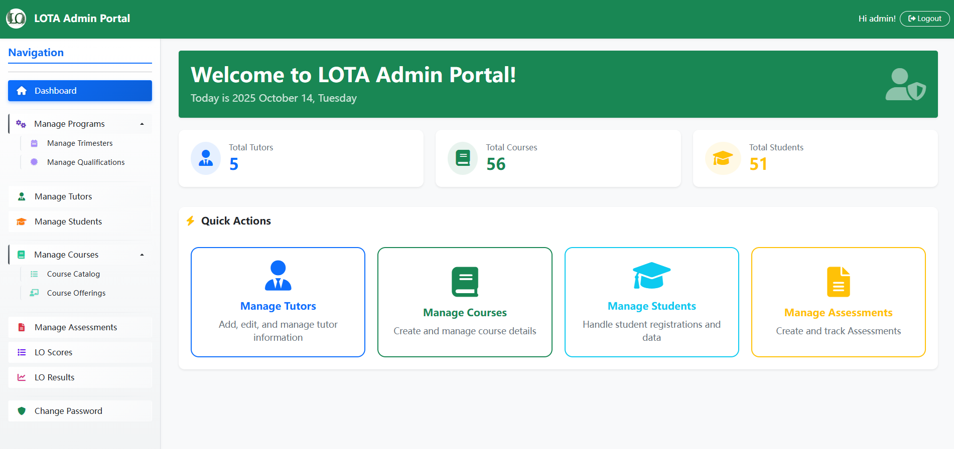
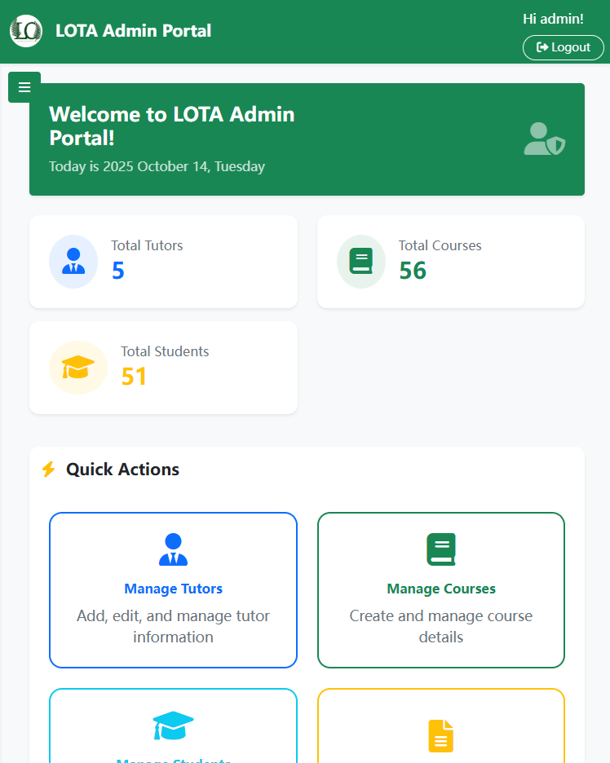
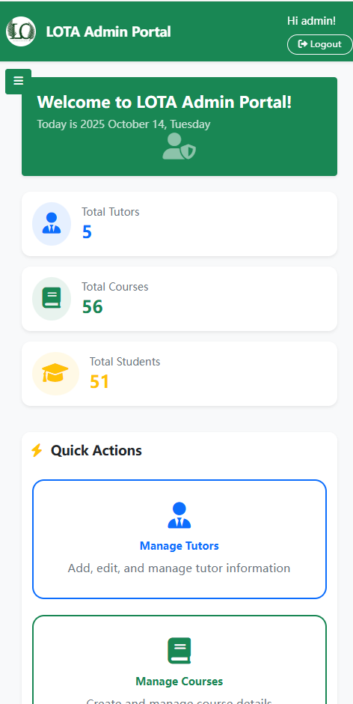
Development
Responsive Design: Multi-Device Support
Support for computers, tablets, mobile phones, and other devices, allowing admin and tutors to work from anywhere, and students to access grades on their phones at any time.
Computer
Tablet
Mobile Phone

Slide 16
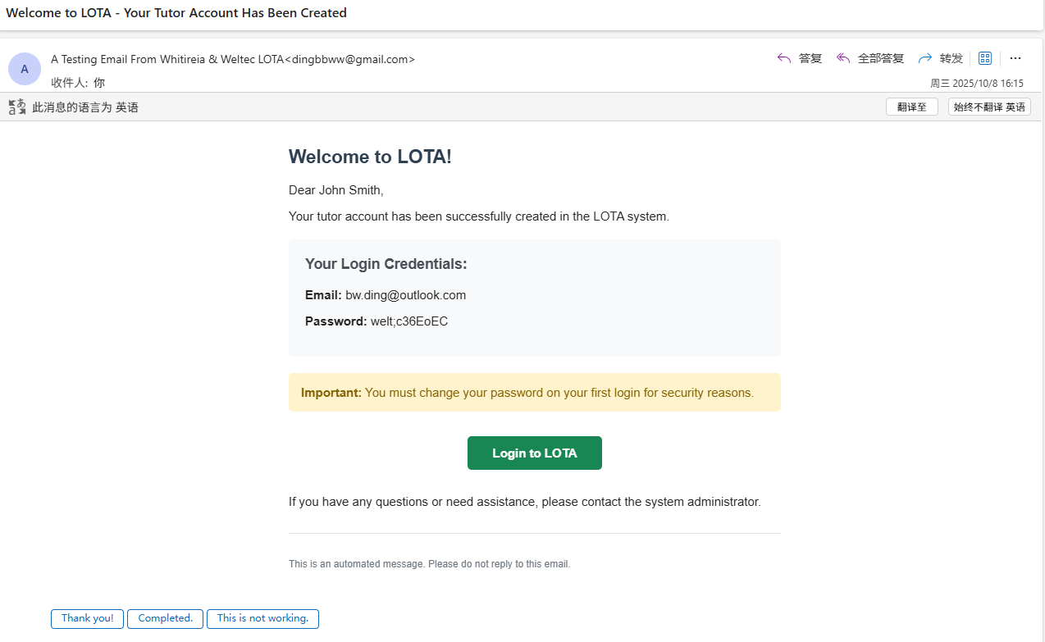
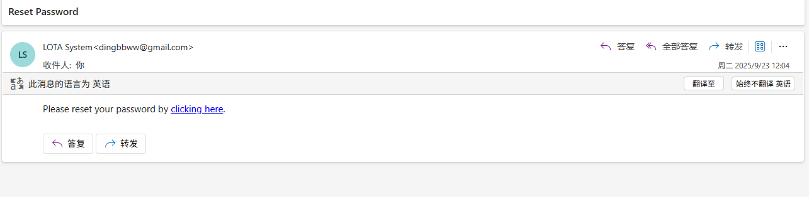
Development
Smart Notification System
LOTA automatically sends account information and important notifications. For example, new users will automatically receive detailed login instructions and email notifications when users update their passwords.
play a video demonstration to showcase the app

Slide 17
Testing
Master test plan
Unit testing: based on method, red (fail) and green (pass)
Integration Testing – Black Box Testing: 454 test cases
System Testing: role-based
User Acceptance Testing
Maintenance Testing - Regression testing

Slide 18
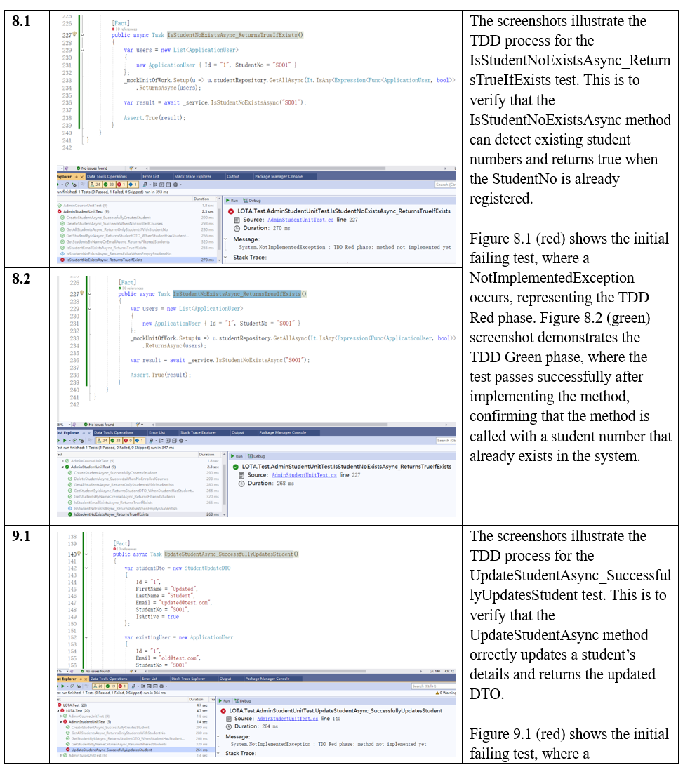
Testing
Unit testing: based on method, red (fail) and green (pass)

Slide 19
Testing
 | Black-Box Testing |  |  | Regression Testing
 | No. of Test Cases | Bugs | Pass/Fail | Pass/Fail
Sprint 1 | 208 | 3 | Pass | Pass
Sprint 2 | 100 | 3 | Pass | Pass
Sprint 3 | 85 | 0 | Pass | Pass
Sprint 4 | 64 | 0 | Pass | Pass

Slide 20
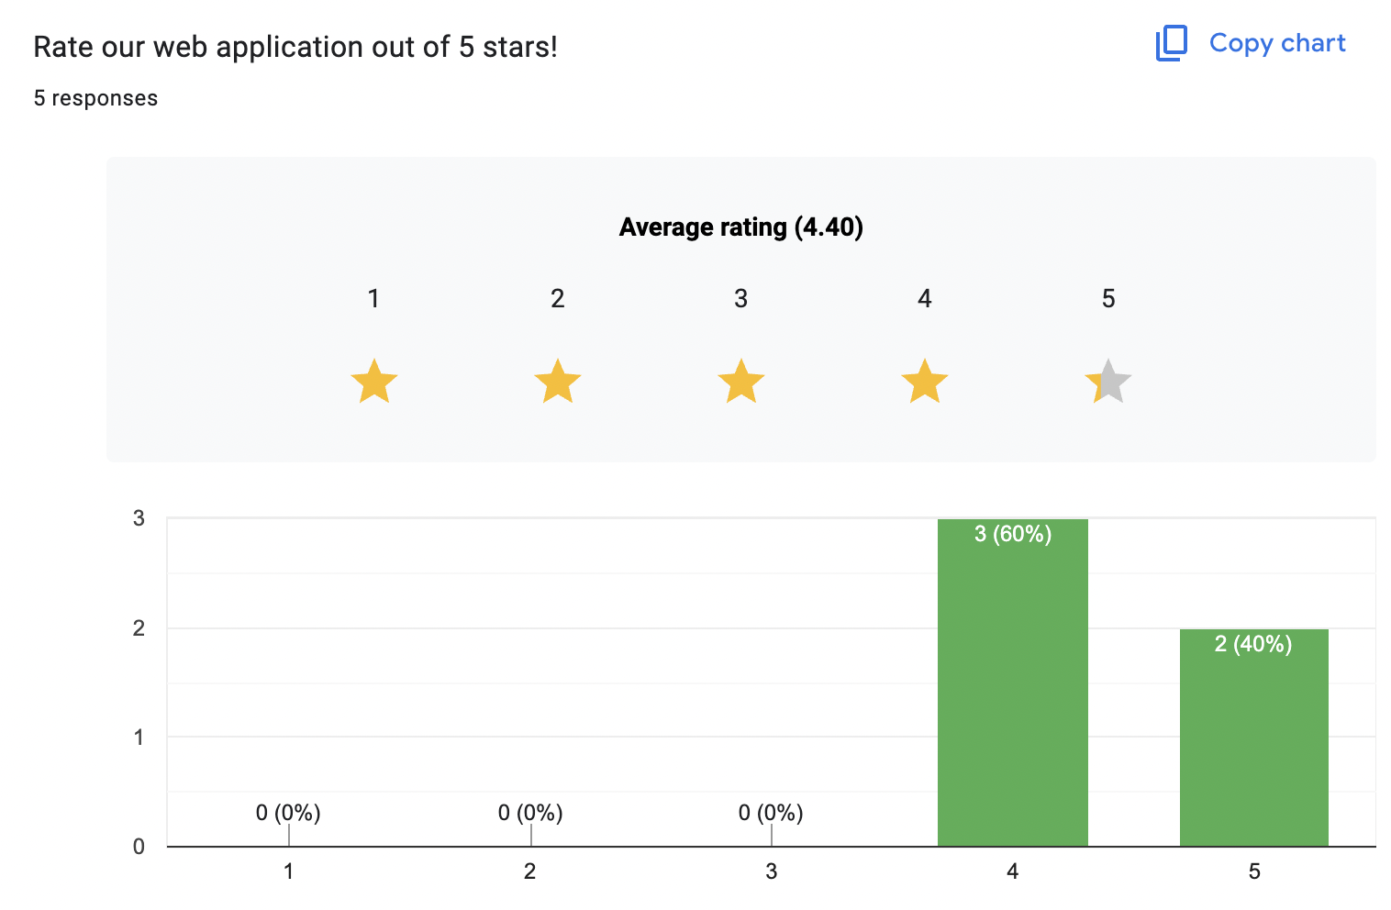
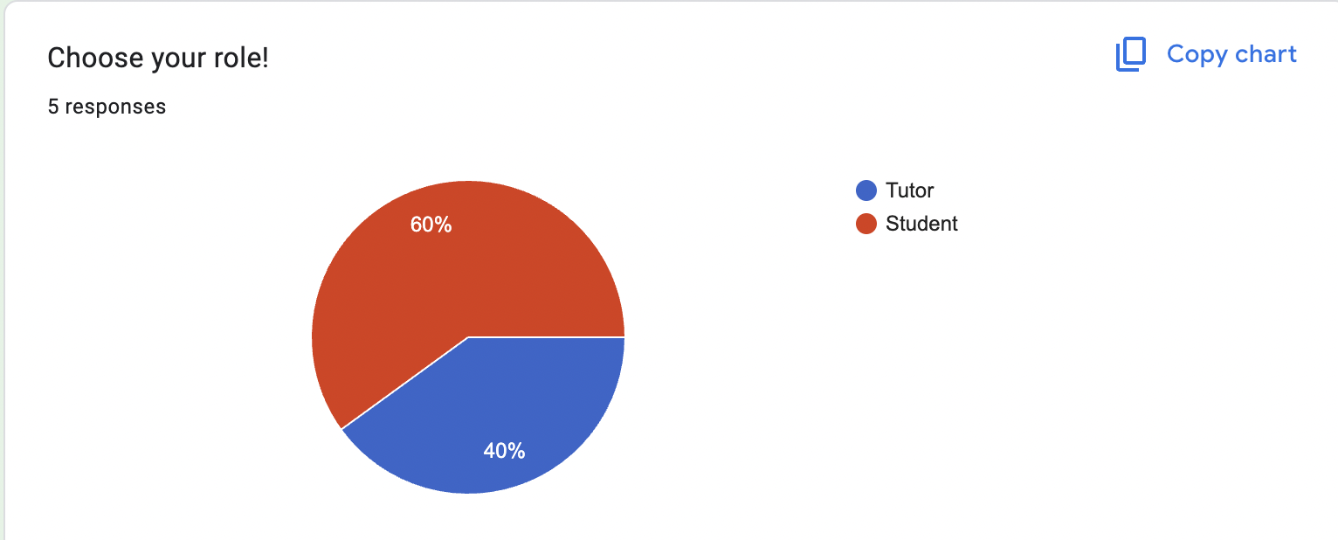
Testing
User Acceptance Testing

Slide 21
Final Documentation and Deliverables
Documents delivered to Client:
Project bid
Project proposal
Web-based application (zip file & GitHub link offered)
Design document
System documentation
Testing documentation and reports
Client meeting agendas and minutes
Client conducting review video
Client closeout report
Instruction videos

Slide 22
Final Documentation and Deliverables
Other documents and work:
3 prototypes
Mid-project progress presentation
Self management review
Advisor meeting agendas and minutes
Team meeting agendas and minutes
Weekly reports (group, individual)
Requirement Tracking Matrix (RTM)
Sprint Retrospective document
LOTA Security Risk & Mitigation Document (based on OWASP Top 10)
Academic closeout report
One-pager
Poster

Slide 23
Client Satisfaction
How was Measured:
Through regular review sessions and feedback after each sprint.
The mid-project progress review with the client evaluated alignment with expectations
Client Concluding Review confirmed that the final system met the client’s goals and quality standards.
Client consistently expressed satisfaction with the project direction, communication, and outcomes.

Slide 24
Potential Future Work
All must-have requirements were completed as scheduled.
In the future:
Client may continue development to include additional “nice-to-have” functions. E.g. export student LOs results; a more complex dashboard for data visualization
Deploy the system either locally within the client’s environment or on the cloud for broader accessibility
Integrate with existing systems
Retake notification email sent from tutor to students.

Slide 25
Challenges
Requirement changes:
Increased from 42 to 55
The team identified additional functions which are necessary to enhance the usability and completeness of the application. E.g. password changing
not come from misunderstanding the client’s requirements or the business logic. Instead, it showed the team’s proactive willingness and effort to ensure a more user-friendly application
Listed in the final version of project proposal
Deleted one requirement, 55 → 54
“The tutor should be able to update student information”, information like email or password should be administrative function.
Before deleting the requirement, the team discussed and confirmed with the advisor and the client.
Documented in Sprint Retrospective document.

Slide 26
Challenges
Maintaining consistent data while updating LOs across multiple users
Solution: implemented role-based access control and strict database validation rules to ensure data accuracy
Synchronizing team collaboration remotely
Solution: used Trello Board for detailed task management and regular team meeting through Zoom

Slide 27
Team Reflection and Skills Developed
Technical skills:
Applied Agile method to the project
Gained practical front-end and back-end development skills
Conducted testing and quality assurance
Used collaboration tools and version control tool
Developed professional documentation skill

Slide 28
Team Reflection and Skills Developed
Professional skills:
Collaboration (flexibility in roles, shared testing work)
Learnt how to interpret business logic, collect requirements, and manage scope
A real-world project from beginning till the end
Communication skills: within the team, with client and advisor
Adaptability and flexibility: adapted to changes quickly
Time management: balanced project deadlines, each milestone deadline, academic schedule, and other course schedule

Slide 29
THANK YOU

